Slide 1
City of Brackettville
Section 3
Public Hearing
April 14, 2026

Slide 2

The City of Brackettville recently received the following grant award:
Grant Contract No. CDV25-0367
Award Amount: $750,000
Project: Street Reconstruction

Slide 3
The grant is funded through the Community Development Block Grant, via:
U.S. Department of Housing and Urban Development
and
Texas Department of Agriculture

Slide 4
Section 3 Concepts
As a condition of funding, the City must comply with Section 3 of the Housing and Urban Development Act of 1968.
To the greatest extent feasible, Grant Recipients must direct economic opportunities generated by CDBG funds to low- and very low-income persons.

Slide 5
Section 3 Concepts
In part, this means ensuring that:
  Section 3 Businesses have the information to submit a bid or proposal for the project; and
  Section 3 Workers have information about any available job opportunities related to the project.
For precise definitions, see TxCDBG Policy Issuance 20-01

Slide 6
Section 3 Business
A company may qualify as a Section 3 Business if:
  it is owned by low-income persons;
  it is owned by Section 8-Assisted housing residents; or
  75% of all labor hours for the business in a 3 month period are performed by Section 3 Workers
Register at:
HUD’s Section 3 website: https://portalapps.hud.gov/Sec3BusReg/BRegistry/RegisterBusiness

Slide 7
Section 3 Business
This project is expected to include the following contracting opportunities:
Grant Administration services – City Grant Writers
Engineering Services(previously selected)–6S Engineering
Prime Contractor for reconstruction of streets
Subcontractors as deemed necessary by contractor

Slide 8
Section 3 Worker
You may qualify as a Section 3 Worker if:
  Your annual income is below the county threshold for your family size:
  You are a current or recent Youthbuild participant
Register your information and search for opportunities at:
  WorkInTexas.gov
  HUD’s Section 3 Opportunity Portal https://hudapps.hud.gov/OpportunityPortal/
  Middle Rio Grande Workforce Center
Notes:
In practice – expect most contractors to calculate the LMI status for all workers based on payroll and family size.

Slide 9
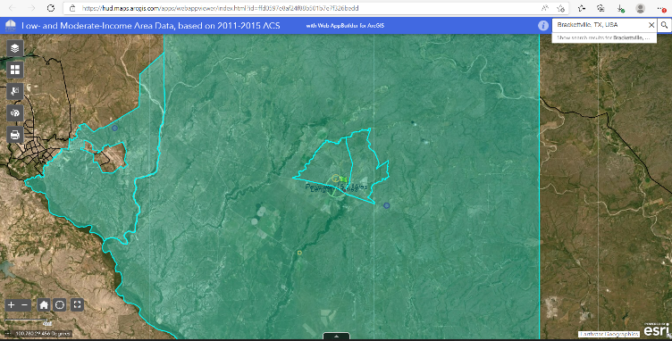
Targeted Section 3 Worker
Section 3 Workers that reside near the project location may also qualify as Targeted Section 3 Workers.
For this project, that service area is defined by this map:
[Service Area Map here]
City of Brackettville – CDV25-0367

Slide 10
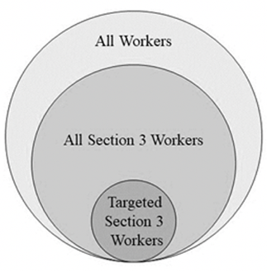
Recordkeeping
The City will track all hours worked on the project based on the three categories of workers.
This will require collection of certain income information.

Slide 11
For More Information
TxCDBG Policy Issuance 20-01
REVISED Policy Issuance 20-01 Section 3 v1.pdf (texasagriculture.gov)
24 CFR Part 75
Electronic Code of Federal Regulations (eCFR)
Mike Aguirre, Mayor

